Slide 1
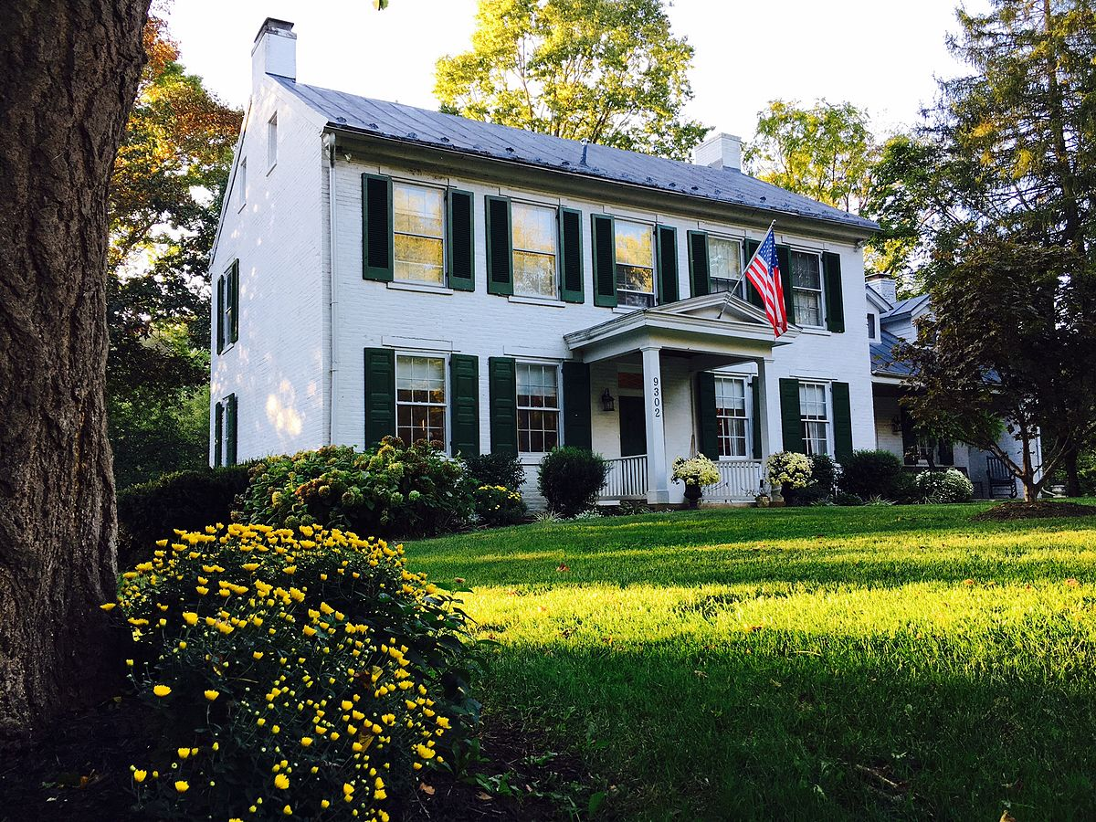
Investing in Real Estate: Ames, IA
Uncovering Undervalued Properties
to Maximize Profitability

Slide 2
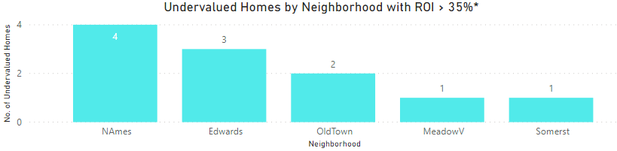
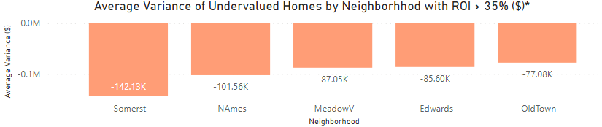
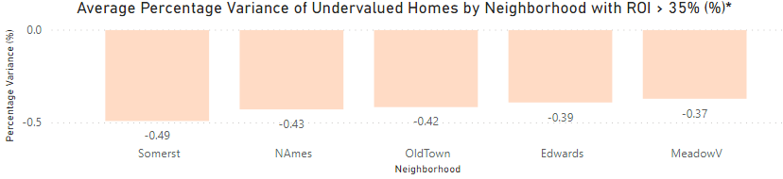
Homes with the most profit potential are undervalued. Top 6 deals: 1 home in Somerset with profit potential of $142K (49% ROI), 4 homes in North Ames worth $102K on average (43% ROI), 1 home in Meadow V. worth $87K (37% ROI), totaling $635K profit potential.
Average Home Valuation Only Shown for Undervalued Homes ($, %)
Key Insights
Eleven undervalued homes in Ames have an ROI > 35% worth $1M profit potential, which also includes:
3 homes in Edwards worth $85K on average (39% ROI)
2 homes in Old Town worth $77K on average (42% ROI)
* Results filtered for undervalued homes with factors typically associated with above-average valuations: garage capacity >= 2 cars, great living area >= 1,200 sq. ft., full baths >= 2, overall quality score 5-8, and total rooms above ground >= 7.
Source: https://www.kaggle.com/pmarcelino/comprehensive-data-exploration-with-python#Out-liars! (accessed 2/24/2020)

Slide 3
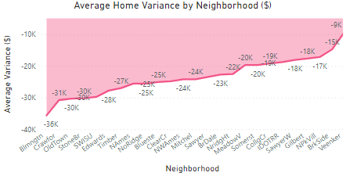
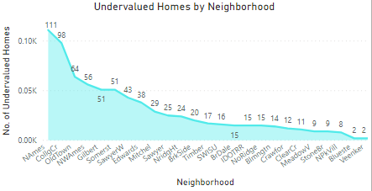
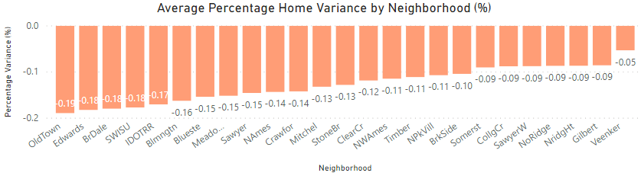
Across all neighborhoods, homes are undervalued by an average of $23,200 (13% ROI). Sixty-four homes in Old Town are currently $30K (19%) below market value, 14 homes in Bloomington are $36K (16%) below, and 12 in Crawford are $31K (14%) below.
Home Variance Only Shown for Undervalued Homes ($, %)
Key Insights
On average, profit potential increases by $1,758 for every percentage point a home is undervalued.
Investing in homes in Old Town represents $1.9M total profit potential, while homes in Bloomington represents $504K, and homes in Crawford represent $372K.
Due to the high no. of undervalued homes, North Ames and College Center are the largest undervalued neighborhoods (worth $2.8M and $1.9M, respectively).
Source: https://www.kaggle.com/pmarcelino/comprehensive-data-exploration-with-python#Out-liars! (accessed 2/24/2020)

Slide 4
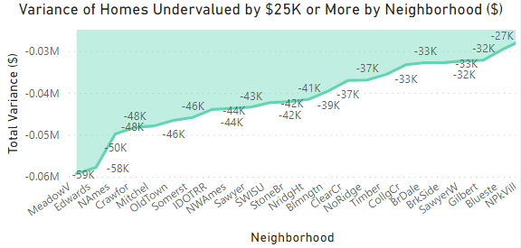
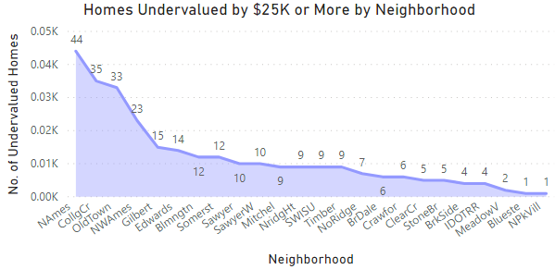
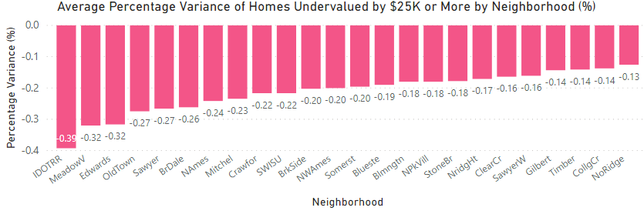
Homes undervalued by $25K+ represent an opportunity of $12.1M. On average, these homes are undervalued by $42K (21% ROI). Two homes in Meadow V. are $59K below market value (32% ROI) and 14 homes in Edwards are $58K below (32% ROI).
Only Shown for Undervalued Homes ($, %)
Key Insights
Forty-four homes in North Ames are $50K below market value (24% ROI).
In total, Ames has 285 homes undervalued by at least $25K (19.5% of all properties).
Investing in these homes in North Ames represents $2.2M total profit potential, while homes in Old Town represents $1.5M, and homes in College Center represent $1.2M.
Source: https://www.kaggle.com/pmarcelino/comprehensive-data-exploration-with-python#Out-liars! (accessed 2/24/2020)

Slide 5
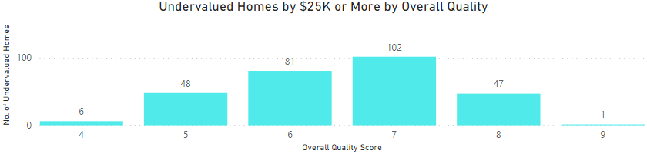
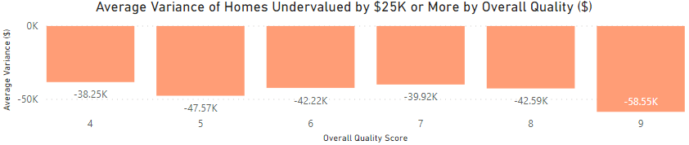
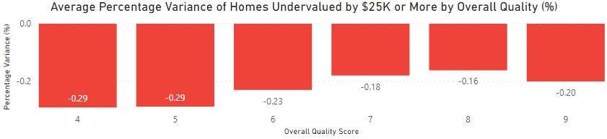
Most homes undervalued by $25K+ have an overall quality score of 6 (81 homes) or a score of 7 (102 homes). Forty-eight homes with a score of 5 are undervalued by $48K on average (29% ROI) and one home with a score of 9 is undervalued by $59K (20% ROI).
Home Variance Only Shown for Undervalued Homes ($, %)
Key Insights
Undervalued homes with overall quality scores of 6 and 7 represent the largest profit opportunities (worth $3.4M and $4.1M, respectively), due to the high no. of homes in these categories.
Investing in homes with an overall quality score of 4 represent $230K total profit potential, while homes with a score of 5 represent $2.3M, and homes with a score of 8 represent $2M.
Source: https://www.kaggle.com/pmarcelino/comprehensive-data-exploration-with-python#Out-liars! (accessed 2/24/2020)

Slide 6
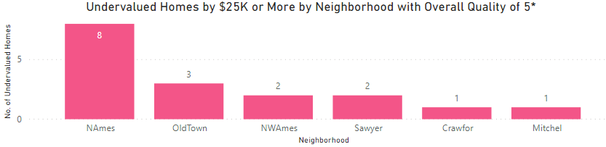
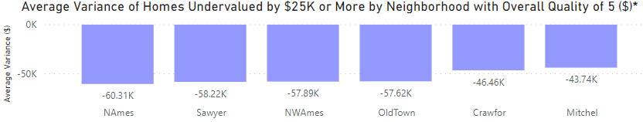
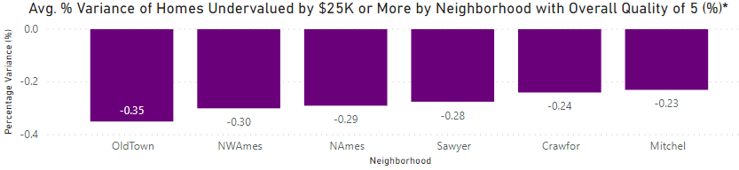
After screening for maximum profitability,* 17 homes with an overall quality score of 5 are below market value by at least $44K on average (23% ROI), including 8 homes in N. Ames that are undervalued by $60K (29%) and 2 in Sawyer undervalued by $58K (28%).
Home Variance Only Shown for Undervalued Homes ($, %)
Key Insights
Total profit potential for undervalued homes with an overall quality of 5 is $978K.
Homes in North Ames and Old Town represent the largest undervalued neighborhoods in this category (worth $480K and $170K, respectively), since 11 out of the 17 homes are located here.
* Results filtered for undervalued homes with factors typically associated with above-average valuations: garage capacity >= 2 cars, great living area >= 1,200 sq. ft., full baths >= 2, and total rooms above ground >= 7.
Source: https://www.kaggle.com/pmarcelino/comprehensive-data-exploration-with-python#Out-liars! (accessed 2/24/2020)

Slide 7
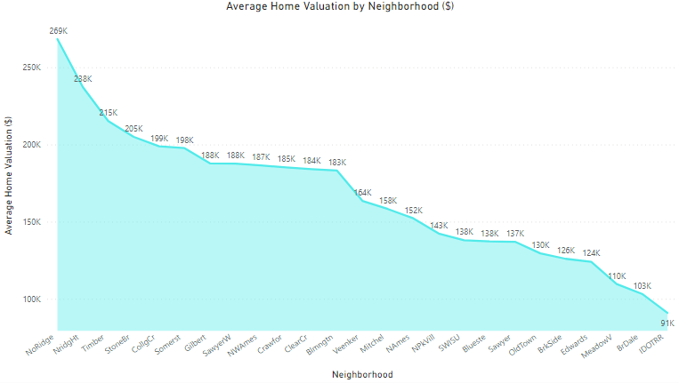
Seven key factors linked to above-average valuation were identified, then used to determine market value and find undervalued homes: overall quality score, great living area, basement size, rooms above ground, garage capacity, full baths, and year built.
Average Home Valuation Only Shown for Undervalued Homes ($)
Key Insights
Data were reviewed for 1,460 properties in 25 neighborhoods in Ames, IA.
Ames is located 30 miles north of Des Moines with a population > 65K, including > 35K students at Iowa State University.
Average price of an undervalued home is $170K (with a mean valuation of $167K).
In 2015, Bloomberg Business ranked Ames as one of “15 Cites That Have Done the Best Since the Recession” and one of the top 25 “Best Places for STEM Grads.”
Ames has > 750 undervalued homes across all neighborhoods.
Sources: https://www.cityofames.org/about-ames/about-ames (accessed 3/2/2020),
https://www.kaggle.com/pmarcelino/comprehensive-data-exploration-with-python#Out-liars! (accessed 2/24/2020)

Slide 8
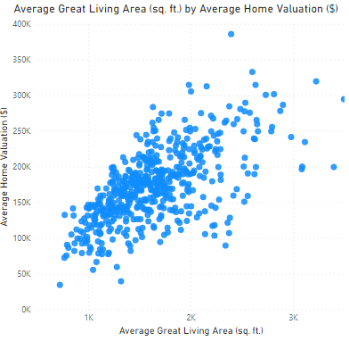
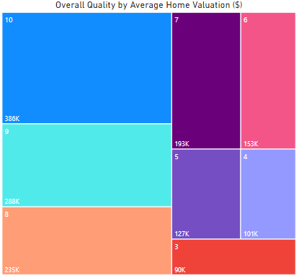
Homes with above average valuation have a great living area starting around 1,200 sq. ft. (accounting for 71% of all homes), and an overall quality score > 6 (43% of all homes). Strategic home improvements should also be considered in advance to boost valuation.
Average Home Valuation Only Shown for Undervalued Homes ($)
Key Insights
Average score for overall quality is 6.3.
Easiest way to increase valuation and boost ROI is by improving overall quality. For each point the score goes up, average valuation increases by $17,000.
Average great living area is 1,580 sq. ft. Enlarging it by 434 sq. ft., increases average valuation by $22,320.
Homes with an overall quality score of 7 are valued 14% above average, while those with a score of 10 are valued 178% above average.
Source: https://www.kaggle.com/pmarcelino/comprehensive-data-exploration-with-python#Out-liars! (accessed 2/24/2020)

Slide 9
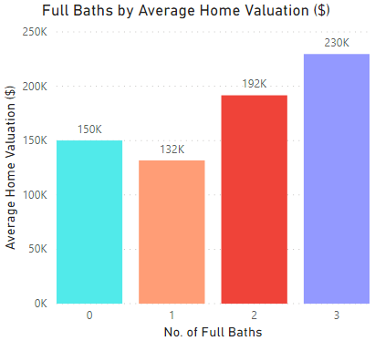
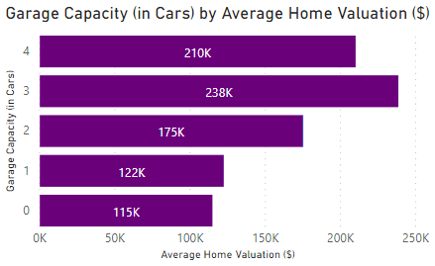
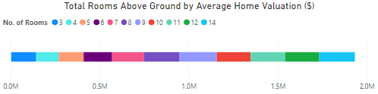
Homes with above average valuation have at least 2 full baths (accounting for 63% of all homes, only 1% have > 2), garage capacity for at least 2 cars, (68% of all homes, only 11% have > 2-car capacity), and at least 7 rooms above ground (88% of all homes).
Average Home Valuation Only Shown for Undervalued Homes ($)
Key Insights
Average no. of full baths is 1.6. For each bathroom added, average valuation increases by $49,000.
Average garage capacity is 1.9 cars. As capacity increases per car, average valuation goes up by $9,723.
Homes with a garage capacity of 3 cars are valued 40% above average, while homes with 4-car capacity have a valuation 24% above average.
Average no. of rooms above ground is 6.7. Homes with 7 rooms have an average valuation of $179,321 (5.5% above average), while homes with 10 have an average valuation of $190,607 (12% above average).
Source: https://www.kaggle.com/pmarcelino/comprehensive-data-exploration-with-python#Out-liars! (accessed 2/24/2020)

Slide 10
Investing in Real Estate: Ames, IA
Key Takeaways:
Ames has 285 homes undervalued by $25K+ worth $12.1M profit potential (21% ROI).
Eleven homes are undervalued > 35%, worth $1M profit potential.
Top five: one home in Somerset with $142K profit potential (49% ROI) and four in North Ames with average profit potential of $102K (43% ROI).

Slide 11
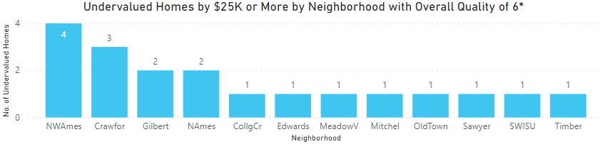
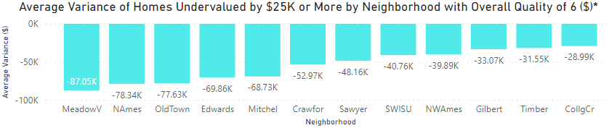
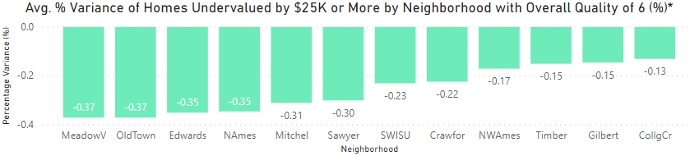
After screening for maximum profitability,* 19 homes with an overall quality score of 6 are below market value by at least $29K on average (13% ROI), including 1 home in Meadow V. undervalued by $87K (37%) and 2 in North Ames undervalued by $78K (35%).
Home Variance Only Shown for Undervalued Homes ($, %)
Key Insights
Total profit potential for undervalued homes with an overall quality of 6 is $994K.
Homes in Crawford, North Ames, and NW Ames represent the largest undervalued neighborhoods in this category (worth $160K apiece), since 9 out of the 19 homes are located here.
* Results filtered for undervalued homes with factors typically associated with above-average valuations: garage capacity >= 2 cars, great living area >= 1,200 sq. ft., full baths >= 2, and total rooms above ground >= 7.
Source: https://www.kaggle.com/pmarcelino/comprehensive-data-exploration-with-python#Out-liars! (accessed 2/24/2020)

Slide 12
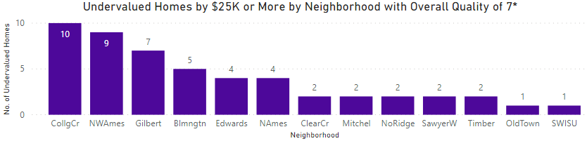
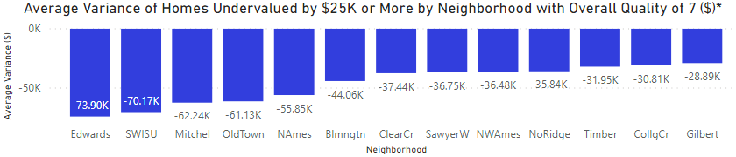
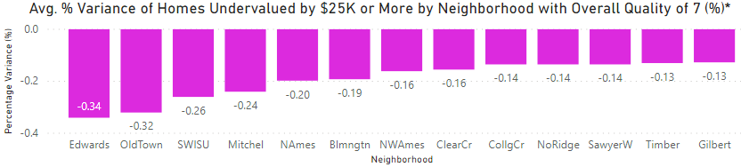
After screening for maximum profitability,* 51 homes with an overall quality score of 7 are undervalued by at least $29K on average (13% ROI), including 4 homes in Edwards that are $74K (34%) below market value and 2 homes in Mitchel that are $62K (24%) below.
Home Variance Only Shown for Undervalued Homes ($, %)
Key Insights
Total profit potential for undervalued homes with an overall quality of 7 is $2.1M.
Homes in NW Ames, College Center, and Edwards represent the largest undervalued neighborhoods in this category (worth $330K, 310K, and $300K, respectively), since 25 out of the 51 homes are located here.
* Results filtered for undervalued homes with factors typically associated with above-average valuations: garage capacity >= 2 cars, great living area >= 1,200 sq. ft., full baths >= 2, and total rooms above ground >= 7.
Source: https://www.kaggle.com/pmarcelino/comprehensive-data-exploration-with-python#Out-liars! (accessed 2/24/2020)

Slide 13
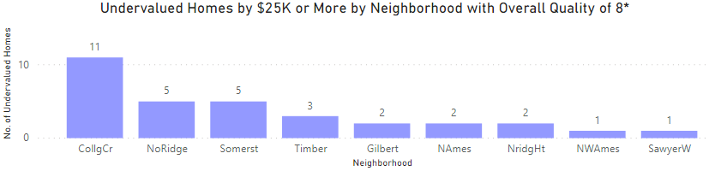
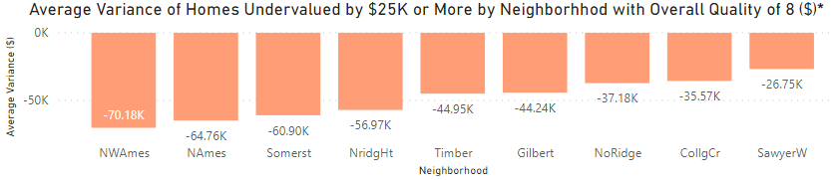
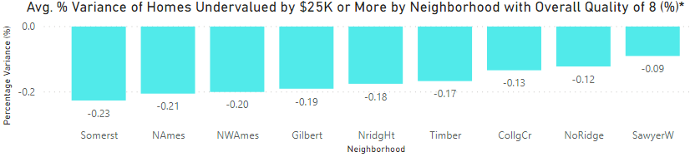
After screening for maximum profitability,* 32 homes with an overall quality score of 8 are undervalued by at least $27K on average (9% ROI), including 1 home in NW Ames that is $70K (20%) below market value and 2 in North Ames that are $65K (21%) below.
Home Variance Only Shown for Undervalued Homes ($, %)
Key Insights
Total profit potential for undervalued homes with an overall quality of 8 is $1.4M.
Homes in College Center, Somerset, and North Ridge, represent the largest undervalued neighborhoods in this category (worth $390K, 300K, and $190K, respectively), since 21 out of the 32 homes are located here.
* Results filtered for undervalued homes with factors typically associated with above-average valuations: garage capacity >= 2 cars, great living area >= 1,200 sq. ft., full baths >= 2, and total rooms above ground >= 7.
Source: https://www.kaggle.com/pmarcelino/comprehensive-data-exploration-with-python#Out-liars! (accessed 2/24/2020)

